Slide 1
Name of the Project: BLOOM
Website:
Wasima Akhter
ID-201811050006
Batch-CSE’50

Slide 2
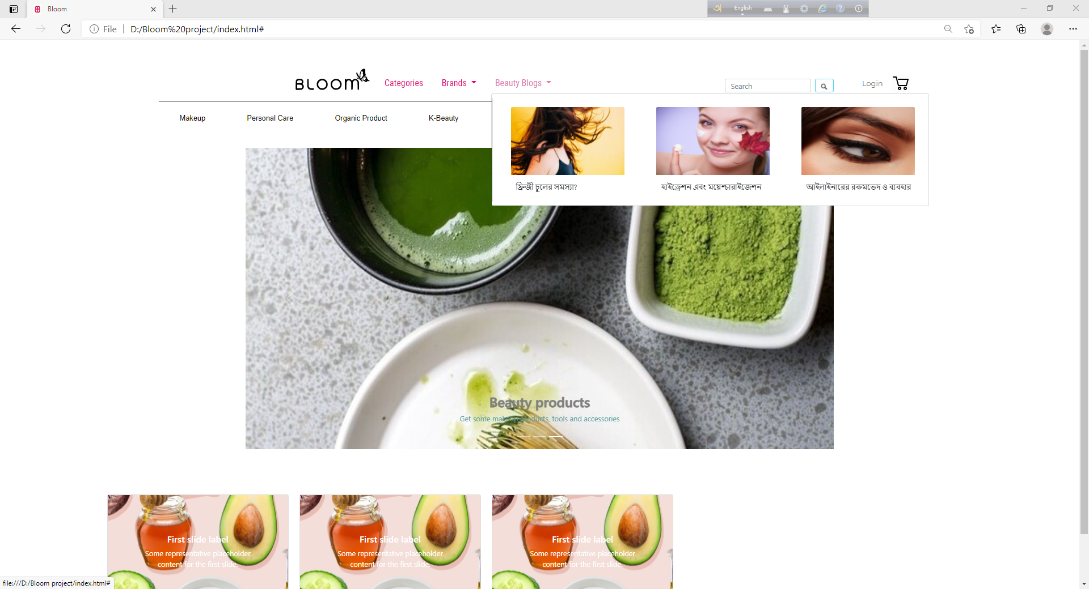

Slide 3
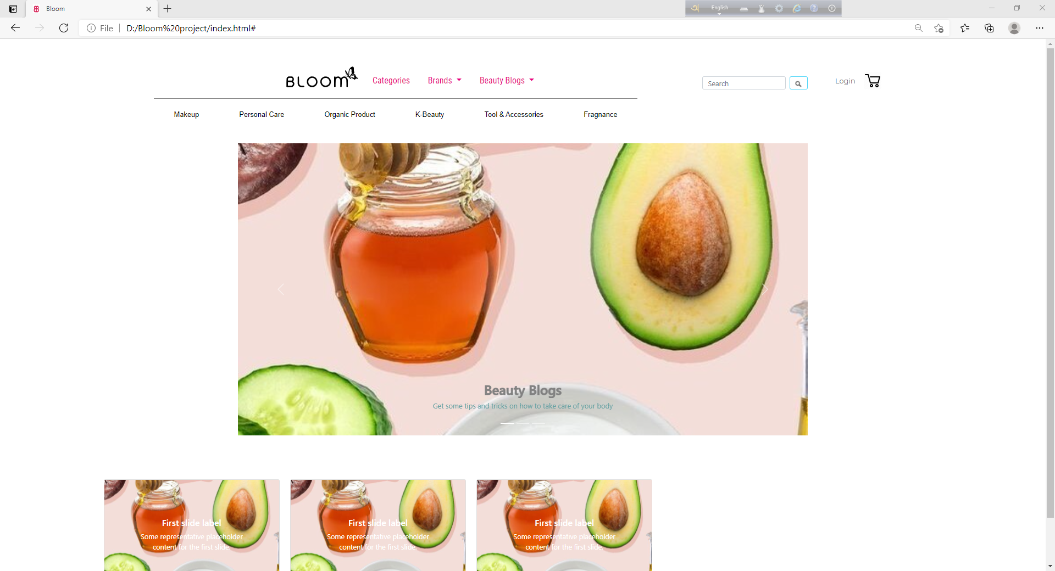
Project Introduction

Slide 4
Homepage
It’s a beauty product shopping website.
Has homepage displaying each type of product as highlights.
Navbar
Has categories to navigate customers to their desired products.
Has a carousel showing different services- like: Beauty blogs, Organic products and Beauty Products

Slide 5
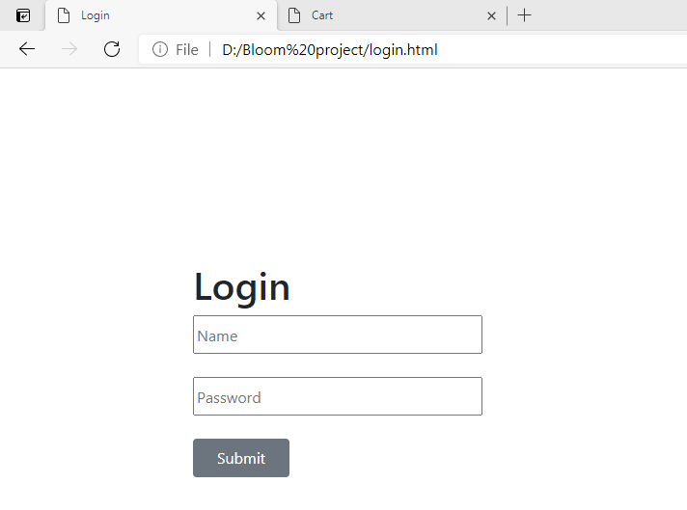
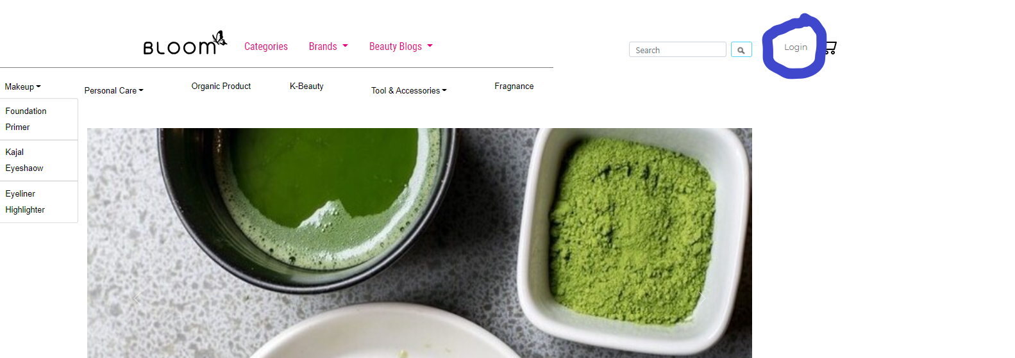
Login to buy added products

Slide 6
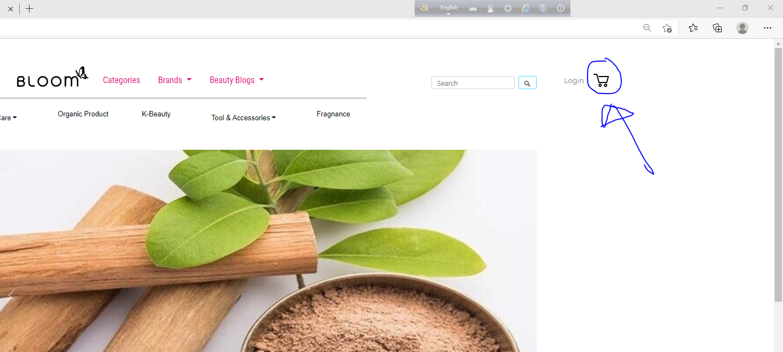
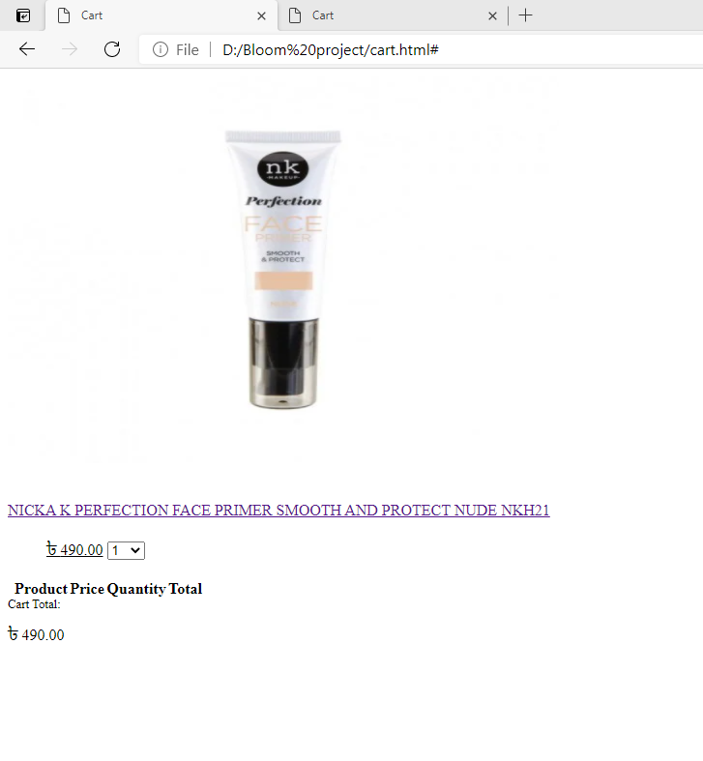
Cart page to calculate total cost
Cart sign

